Slide 1
Knowledge Management

Slide 2

What Exactly Is Knowledge Management?
We found many different definitions, but the one that best fit our understanding of KM….

Slide 3
Definition:
“Any structured activity that improves an organization’s capacity to acquire, share, and utilize knowledge in ways that improves its survival and success.”

Slide 4

It also helps to understand,
“KM is not a technology, but a strategic solution that applies information technology.”

Slide 5

Why have KM?
Quite simply, most firms do not know what they know. Information is passed along too slowly, and sometimes not available to those who would use it to make costly decisions.

Slide 6
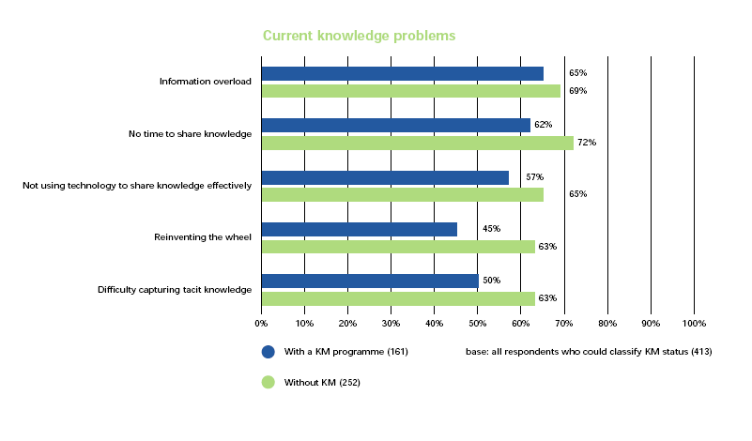
KM helps to eliminate knowledge problems
In every instance, the company’s with KM in place have a lower occurrence of knowledge problems than those without KM.

Slide 7
Basics of KM
In order to understand what the definition means, and how it can pertain to business, one must first understand a few basics of knowledge management.

Slide 8
KM: The Basics
Knowledge Management
Tacit Knowledge
Explicit Knowledge
Knowledge
Information
Data
SourceReference 1

Slide 9
Knowledge Management: Data
“A set of discrete facts” (Davenport and Prusak, 1998).
“Text that does not answer questions to a particular problem” (Quigley and Debons, 1999).
An Example would be: Company K has a $4 million budget for the in house IT department.
Data

Slide 10
Knowledge Management: Information
“Facts organized to describe a situation or condition” (Wiig, 1993).
“Data with relevance and purpose” (Davenport, 1997).
Example: The $4 million budget for Company K was a 20% increase over the 2003 budget.
Information

Slide 11
Knowledge Management: Knowledge
Knowledge is processed information.
“Valuable information from the human mind” (Davenport, 1997).
“Text that answers the questions why or how” (Quigley and Debons, 1999).
Example: The increase of Company K’s IT budget is due to the competitive edge that the in house Knowledge Management Program has helped to generate.
Knowledge

Slide 12
Knowledge
Knowledge can be divided into two categories:
and
Tacit
Explicit

Slide 13

Tacit Knowledge
“Know how”
Difficult to describe
“It can be demonstrated but rarely codified, and resides with its holder. It gets transferred through demonstration and on-the-job training.”
Examples include riding a bike and throwing a ball.

Slide 14

Explicit Knowledge
Explicit knowledge is much more easier to pass from one person to the other. It can be written out in step by step guidelines to follow to complete a task.
An example of tacit knowledge is the ability to create a power point slide.

Slide 15
Tools for knowledge Management
Database Management tools
  For data management and seeking knowledge through SQL queries
Data warehousing, data mart, data mining tools
  For business information creation and using Data Mining tools, OLAP tools to seek knowledge on different views and scenarios
Process modeling and management tools
  For recording standard process as an explicit knowledge for use in the orgn.
Work flow management tools
  For recording the process of workflow as an explicit knowledge for group workers
Search engine tool
  For locating specific information through search algorithms
Document management tools – like Lotus notes.
  DBMS tools for documents. Useful to search and manipulate documents
Web based tools
  Eg. www.infoseek.com, www.eloquent.com

Slide 16
Difficulties of Implementing Knowledge Management
Convince employees that it is in their best interest to share knowledge. This goes against conventional thought that says knowledge is power, so become more powerful than others.
“While employees may not deliberately hoard their knowledge, convincing them to make the time to participate in and contribute to a knowledge management system or community can be a challenge.”
Deciding which information should be retained.

